Slide 1

SDC PROJECT REVIEW – 1
Personal Portfolio Website
A modern, SEO-optimized personal web platform engineered with HTML5, CSS Grid/Flexbox, and ES6 JavaScript.
PROJECT TEAM (CSE, KL UNIVERSITY)
Abhishek Kumar
Chaitanya Karande
Deepak Kumar

Slide 2


01. PROBLEM STATEMENT
Challenges in Online Professional Identity
Static Resume Limitations
Static documents cannot demonstrate interactive web code or live responsive layouts.
Fragmented Achievements
Projects, repos, and blogs are scattered across disconnected platforms.
Low Recruiter Discoverability
Without dedicated SEO optimization, showcasing work effectively to employers is difficult.

Slide 3


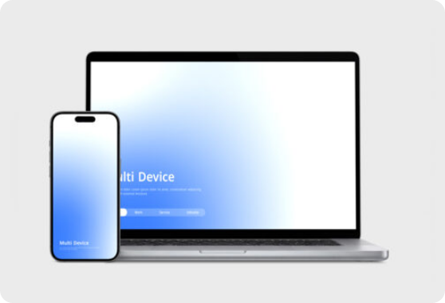


02. PROPOSED SOLUTION
Modern Personal Portfolio Web Platform
All-in-One Digital Hub
Integrates galleries, blogs, skill breakdowns, and contact options into one location.
Responsive & Modern UI
CSS Grid and Flexbox layouts built with an instant Light/Dark Mode toggle.
SEO-Optimized Structure
Semantic HTML5 tags to maximize search engine indexing and recruiter visibility.

Slide 4
03. CORE OBJECTIVES
Technical & Operational Goals
01
02
03
04
Showcase Portfolio Items
Pure Front-End Mastery
Interactive User Experience
SEO & Standard Compliance
Detailed project galleries and case studies.
Built strictly with Vanilla HTML5, CSS3, and ES6 JS.
Local Storage auth, dark mode, and smooth section routing.
Semantic HTML markup for search engine discovery.

Slide 5


04. SYSTEM ARCHITECTURE
Module Architecture & Functional Split
MODULE 01
MODULE 02
Admin Module
User Module
Content Management: Site owner content updates
Public Exploration: Browse projects, skills & articles
Portfolio Management: Add, edit, or delete items
Contact Form: Send direct inquiries to site owner
Blog Oversight: Create and manage published articles
Theme Customization: Toggle Light & Dark mode
Client Routing: Fast JS-based section navigation
Contact Inquiries: View submitted visitor messages

Slide 6

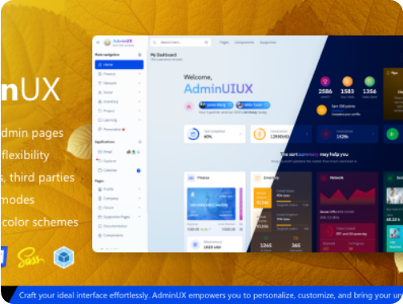
05. ADMIN FEATURES
Admin Module: Content Operations
Manage Projects
Add, update, or remove project cards, live demo links, and GitHub repository URLs.
Manage Blog Posts
Create, edit, and categorize blog articles and technical notes for visitors.
Contact Form Oversight
Review and manage feedback and messages submitted by potential employers.

Slide 7



06. USER EXPERIENCE
User Module: Visitor Experience
Portfolio Exploration
Interactive Engagement
Module Redirection
Browse project galleries, technical blogs, and skill breakdowns seamlessly.
Submit direct messages via the contact form and toggle themes dynamically.
Fast, client-side section switching powered purely by Vanilla JavaScript.

Slide 8
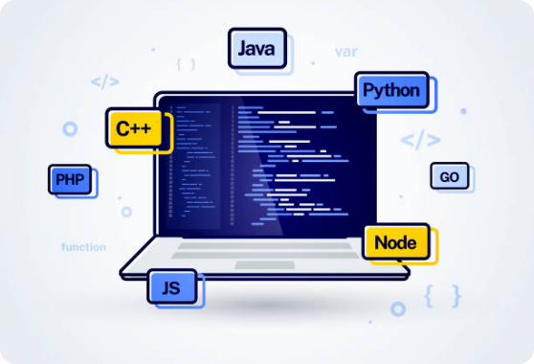
07. TECHNOLOGY STACK
Core Implementation Stack
HTML5 & CSS3
Semantic architecture with CSS Grid & Flexbox layouts.
Vanilla JavaScript (ES6)
DOM manipulation, event handling & dynamic routing.
Local Storage Auth
Client-side auth persistence & theme state memory.
GitHub Version Control
Hosted repository with GitHub Pages live deployment.

Slide 9
08. UI STRUCTURE
Core UI Sections & Interactive Utilities
Core UI Sections
Interactive Utilities
• Home Section: Hero bio & primary Call To Action
• Authentication Flow: Local Storage login screens
• About & Skills: Categorized technical skill badges
• Dark Mode Toggle: Instant theme switching with CSS vars
• Projects Gallery: Responsive Grid with demo links
• Fluid Responsive Alignment: CSS Grid & Flexbox
• Blogs Section: Article cards with reading views
• Single-Page Experience: Fast section redirection
• Contact Form: Interactive feedback & inquiry fields
• Live Hosting: GitHub Pages hosted for testing

Slide 10
09. SUMMARY & ROADMAP
Conclusion & Future Scope
Key Learning Outcomes
Future Enhancements
Responsive layout design with Grid/Flexbox
Backend Integration with Node.js & REST APIs
Auth & theme persistence with Local Storage
Database Storage migration to MongoDB / SQL
Practical DOM & JS event handling
Custom Domain & SSL security setup
GitHub version control & deployment
Framer Motion & EmailJS API integration

Slide 11





Image Sources
https://img.magnific.com/premium-photo/modern-workspace-aesthetic-with-coffee-laptop-programming-code-colorful-light-environment_1288053-15163.jpg?semt=ais_hybrid&w=740&q=80
Source: www.magnific.com
https://www.theforage.com/blog/wp-content/uploads/2022/11/online-portfolio.jpg
Source: careerservices.upenn.edu
https://www.mockupworld.co/wp-content/uploads/dynamic/2026/05/free-laptop-and-smartphone-screen-mockup-536x0-c-default.jpg
Source: www.mockupworld.co
https://www.adminuiux.com/wp-content/uploads/2025/08/01_banner-adminux.png
Source: www.adminuiux.com
https://media.istockphoto.com/id/1314492642/vector/vector-illustration-web-development-programming-coding-icon-laptop-with-program-code-on-the.jpg?s=612x612&w=0&k=20&c=ZuF1wXrA2QK3y_n_FNZBFZEk0RSdekIKYnHBFS1ZjGI=
Source: www.istockphoto.com

